Slide 1
Risk management
Risk management is concerned with identifying risks and drawing up plans to minimise their effect on a project.
A risk is a probability that some adverse circumstance will occur
Project risks affect schedule or resources;
Product risks affect the quality or performance of the software being developed;
Business risks affect the organisation developing or procuring the software.

Slide 2
Software risks

Slide 3
The risk management process
Risk identification
Identify project, product and business risks;
Risk analysis
Assess the likelihood and consequences of these risks;
Risk planning
Draw up plans to avoid or minimise the effects of the risk;
Risk monitoring
Monitor the risks throughout the project;

Slide 4
The risk management process

Slide 5
Risk identification
Technology risks.
People risks.
Organisational risks.
Requirements risks.
Estimation risks.

Slide 6
Risks and risk types

Slide 7
Risk analysis
Assess probability and seriousness of each risk.
Probability may be very low, low, moderate, high or very high.
Risk effects might be catastrophic, serious, tolerable or insignificant.

Slide 8
Risk analysis (i)

Slide 9
Risk analysis (ii)

Slide 10
Risk planning
Consider each risk and develop a strategy to manage that risk.
Avoidance strategies
The probability that the risk will arise is reduced;
Minimisation strategies
The impact of the risk on the project or product will be reduced;
Contingency plans
If the risk arises, contingency plans are plans to deal with that risk;

Slide 11
Risk management strategies (i)

Slide 12
Risk management strategies (ii)

Slide 13
Risk monitoring
Assess each identified risks regularly to decide whether or not it is becoming less or more probable.
Also assess whether the effects of the risk have changed.
Each key risk should be discussed at management progress meetings.

Slide 14
Risk indicators

Slide 15
Risk Projection
Risk projection, also called risk estimation, attempts to rate each risk in two ways
the likelihood or probability that the risk is real
the consequences of the problems associated with the risk, should it occur.
The are four risk projection steps:
establish a scale that reflects the perceived likelihood of a risk
delineate the consequences of the risk
estimate the impact of the risk on the project and the product,
note the overall accuracy of the risk projection so that there will be no misunderstandings.

Slide 16
Building a Risk Table
Risk
Probability
Impact
RMMM
Risk
Mitigation
Monitoring
&
Management

Slide 17
Building the Risk Table
Estimate the probability of occurrence
Estimate the impact on the project on a scale of 1 to 5, where
1 = low impact on project success
5 = catastrophic impact on project success
sort the table by probability and impact

Slide 18
Risk Exposure (Impact)
The overall risk exposure, RE, is determined using the following relationship [HAL98]:
RE = P x C
where
P is the probability of occurrence for a risk, and
C is the cost to the project should the risk occur.

Slide 19
Risk Exposure Example
Risk identification. Only 70 percent of the software components scheduled for reuse will, in fact, be integrated into the application. The remaining functionality will have to be custom developed.
Risk probability. 80% (likely).
Risk impact. 60 reusable software components were planned. If only 70 percent can be used, 18 components would have to be developed from scratch (in addition to other custom software that has been scheduled for development). Since the average component is 100 LOC and local data indicate that the software engineering cost for each LOC is $14.00, the overall cost (impact) to develop the components would be 18 x 100 x 14 = $25,200.
Risk exposure. RE = 0.80 x 25,200 ~ $20,200.

Slide 20
Recording Risk Information
Project: Embedded software for XYZ system
Risk type: schedule risk
Priority (1 low ... 5 critical): 4
Risk factor: Project completion will depend on tests which require
hardware component under development. Hardware component
delivery may be delayed
Probability: 60 %
Impact: Project completion will be delayed for each day that
hardware is unavailable for use in software testing
Monitoring approach:
Scheduled milestone reviews with hardware group
Contingency plan:
Modification of testing strategy to accommodate delay using
software simulation
Estimated resources: 6 additional person months beginning 7-1-96

Slide 21
Process improvement
Process improvement means understanding existing processes and changing these processes to increase product quality and/or reduce costs and development time.

Slide 22
Approaches to improvement
The process maturity approach, which focuses on improving process and project management and introducing good software engineering practice.
The level of process maturity reflects the extent to which good technical and management practice has been adopted in organizational software development processes.
The agile approach, which focuses on iterative development and the reduction of overheads in the software process.
The primary characteristics of agile methods are rapid delivery of functionality and responsiveness to changing customer requirements.

Slide 23
The process improvement cycle

Slide 24
Process improvement activities
Process measurement
You measure one or more attributes of the software process or product. These measurements forms a baseline that helps you decide if process improvements have been effective.
Process analysis
The current process is assessed, and process weaknesses and bottlenecks are identified. Process models (sometimes called process maps) that describe the process may be developed.
Process change
Process changes are proposed to address some of the identified process weaknesses. These are introduced and the cycle resumes to collect data about the effectiveness of the changes.

Slide 25
Process metrics
Time taken for process activities to be completed
E.g. Calendar time or effort to complete an activity or process.
Resources required for processes or activities
E.g. Total effort in person-days.
Number of occurrences of a particular event
E.g. Number of defects discovered.

Slide 26
The SEI capability maturity model
Initial
Essentially uncontrolled
Repeatable
Product management procedures defined and used
Defined
Process management procedures and strategies defined and used
Managed
Quality management strategies defined and used
Optimising
Process improvement strategies defined and used

Slide 27
Software Engineering: A Practitioner’s Approach, 6/e Project Scheduling copyright © 1996, 2001, 2005 R.S. Pressman & Associates, Inc. For University Use Only May be reproduced ONLY for student use at the university level when used in conjunction with Software Engineering: A Practitioner's Approach. Any other reproduction or use is expressly prohibited.

Slide 28
Why Are Projects Late?
an unrealistic deadline established by someone outside the software development group
changing customer requirements that are not reflected in schedule changes;
an honest underestimate of the amount of effort and/or the number of resources that will be required to do the job;
predictable and/or unpredictable risks that were not considered when the project commenced;
technical difficulties that could not have been foreseen in advance;
human difficulties that could not have been foreseen in advance;
miscommunication among project staff that results in delays;
a failure by project management to recognize that the project is falling behind schedule and a lack of action to correct the problem

Slide 29
Timeline Charts
Tasks
Week 1
Week 2
Week 3
Week 4
Week n
Task 1
Task 2
Task 3
Task 4
Task 5
Task 6
Task 7
Task 8
Task 9
Task 10
Task 11
Task 12

Slide 30
Use Automated Tools to Derive a Timeline Chart

Slide 31
Chapter 36
Maintenance and Reengineering
Slide Set to accompany Software Engineering: A Practitioner’s Approach, 8/e
by Roger S. Pressman and Bruce R. Maxim
Slides copyright © 1996, 2001, 2005, 2009, 2014 by Roger S. Pressman
For non-profit educational use only
May be reproduced ONLY for student use at the university level when used in conjunction with Software Engineering: A Practitioner's Approach, 8/e. Any other reproduction or use is prohibited without the express written permission of the author.
All copyright information MUST appear if these slides are posted on a website for student use.
These slides are designed to accompany Software Engineering: A Practitioner’s Approach, 8/e (McGraw-Hill 2014). Slides copyright 2014 by Roger Pressman.
31
Notes:
31

Slide 32
Software Maintenance
Software is released to end-users, and
within days, bug reports filter back to the software engineering organization.
within weeks, one class of users indicates that the software must be changed so that it can accommodate the special needs of their environment.
within months, another corporate group who wanted nothing to do with the software when it was released, now recognizes that it may provide them with unexpected benefit. They’ll need a few enhancements to make it work in their world.
All of this work is software maintenance
These slides are designed to accompany Software Engineering: A Practitioner’s Approach, 8/e (McGraw-Hill 2014). Slides copyright 2014 by Roger Pressman.
32
Notes:
32

Slide 33
Maintainable Software
Maintainable software exhibits effective modularity
It makes use of design patterns that allow ease of understanding.
It has been constructed using well-defined coding standards and conventions, leading to source code that is self-documenting and understandable.
It has undergone a variety of quality assurance techniques that have uncovered potential maintenance problems before the software is released.
It has been created by software engineers who recognize that they may not be around when changes must be made.
Therefore, the design and implementation of the software must “assist” the person who is making the change
These slides are designed to accompany Software Engineering: A Practitioner’s Approach, 8/e (McGraw-Hill 2014). Slides copyright 2014 by Roger Pressman.
33
Notes:
33

Slide 34
Software Supportability
“the capability of supporting a software system over its whole product life.
This implies satisfying any necessary needs or requirements, but also the provision of equipment, support infrastructure, additional software, facilities, manpower, or any other resource required to maintain the software operational and capable of satisfying its function.” [SSO08]
The software should contain facilities to assist support personnel when a defect is encountered in the operational environment (and make no mistake, defects will be encountered).
Support personnel should have access to a database that contains records of all defects that have already been encountered—their characteristics, cause, and cure.
These slides are designed to accompany Software Engineering: A Practitioner’s Approach, 8/e (McGraw-Hill 2014). Slides copyright 2014 by Roger Pressman.
34
Notes:
34

Slide 35
Reengineering
Business
processes
IT
systems
Software
applications
Reengineering
These slides are designed to accompany Software Engineering: A Practitioner’s Approach, 8/e (McGraw-Hill 2014). Slides copyright 2014 by Roger Pressman.
35
Notes:
35

Slide 36
Business Process Reengineering
Business definition. Business goals are identified within the context of four key drivers: cost reduction, time reduction, quality improvement, and personnel development and empowerment.
Process identification. Processes that are critical to achieving the goals defined in the business definition are identified.
Process evaluation. The existing process is thoroughly analyzed and measured.
Process specification and design. Based on information obtained during the first three BPR activities, use-cases are prepared for each process that is to be redesigned.
Prototyping. A redesigned business process must be prototyped before it is fully integrated into the business.
Refinement and instantiation. Based on feedback from the prototype, the business process is refined and then instantiated within a business system.
These slides are designed to accompany Software Engineering: A Practitioner’s Approach, 8/e (McGraw-Hill 2014). Slides copyright 2014 by Roger Pressman.
36
Notes:
36

Slide 37
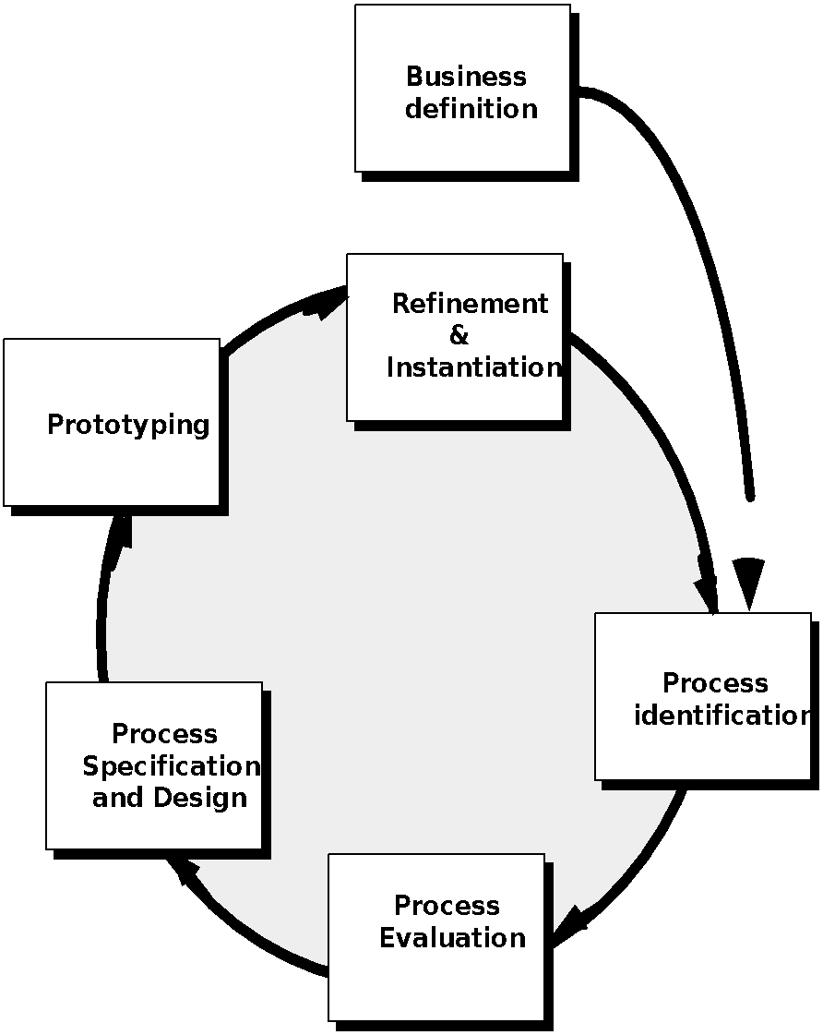
Business Process Reengineering
These slides are designed to accompany Software Engineering: A Practitioner’s Approach, 8/e (McGraw-Hill 2014). Slides copyright 2014 by Roger Pressman.
37
Notes:
37

Slide 38
BPR Principles
Organize around outcomes, not tasks.
Have those who use the output of the process perform the process.
Incorporate information processing work into the real work that produces the raw information.
Treat geographically dispersed resources as though they were centralized.
Link parallel activities instead of integrated their results. When different
Put the decision point where the work is performed, and build control into the process.
Capture data once, at its source.
These slides are designed to accompany Software Engineering: A Practitioner’s Approach, 8/e (McGraw-Hill 2014). Slides copyright 2014 by Roger Pressman.
38
Notes:
38

Slide 39
Software Reengineering
Forward
engineering
inventory
analysis
Data
restructuring
document
restructuring
code
restructuring
reverse
engineering
These slides are designed to accompany Software Engineering: A Practitioner’s Approach, 8/e (McGraw-Hill 2014). Slides copyright 2014 by Roger Pressman.
39
Notes:
39

Slide 40
Inventory Analysis
build a table that contains all applications
establish a list of criteria, e.g.,
name of the application
year it was originally created
number of substantive changes made to it
total effort applied to make these changes
date of last substantive change
effort applied to make the last change
system(s) in which it resides
applications to which it interfaces, ...
analyze and prioritize to select candidates for reengineering
These slides are designed to accompany Software Engineering: A Practitioner’s Approach, 8/e (McGraw-Hill 2014). Slides copyright 2014 by Roger Pressman.
40
Notes:
40

Slide 41
Document Restructuring
Weak documentation is the trademark of many legacy systems.
But what do we do about it? What are our options?
Options …
Creating documentation is far too time consuming. If the system works, we’ll live with what we have. In some cases, this is the correct approach.
Documentation must be updated, but we have limited resources. We’ll use a “document when touched” approach. It may not be necessary to fully redocument an application.
The system is business critical and must be fully redocumented. Even in this case, an intelligent approach is to pare documentation to an essential minimum.
These slides are designed to accompany Software Engineering: A Practitioner’s Approach, 8/e (McGraw-Hill 2014). Slides copyright 2014 by Roger Pressman.
41
Notes:
41

Slide 42
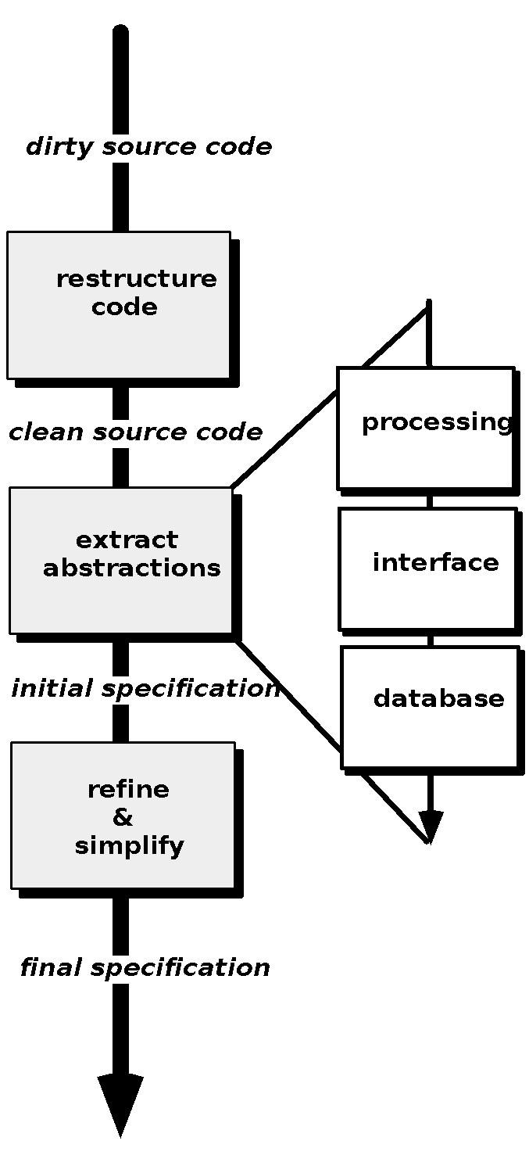
Reverse Engineering
These slides are designed to accompany Software Engineering: A Practitioner’s Approach, 8/e (McGraw-Hill 2014). Slides copyright 2014 by Roger Pressman.
42
Notes:
42

Slide 43
Code Restructuring
Source code is analyzed using a restructuring tool.
Poorly design code segments are redesigned
Violations of structured programming constructs are noted and code is then restructured (this can be done automatically)
The resultant restructured code is reviewed and tested to ensure that no anomalies have been introduced
Internal code documentation is updated.
These slides are designed to accompany Software Engineering: A Practitioner’s Approach, 8/e (McGraw-Hill 2014). Slides copyright 2014 by Roger Pressman.
43
Notes:
43

Slide 44
Data Restructuring
Unlike code restructuring, which occurs at a relatively low level of abstraction, data structuring is a full-scale reengineering activity
In most cases, data restructuring begins with a reverse engineering activity.
Current data architecture is dissected and necessary data models are defined (Chapter 9).
Data objects and attributes are identified, and existing data structures are reviewed for quality.
When data structure is weak (e.g., flat files are currently implemented, when a relational approach would greatly simplify processing), the data are reengineered.
Because data architecture has a strong influence on program architecture and the algorithms that populate it, changes to the data will invariably result in either architectural or code-level changes.
These slides are designed to accompany Software Engineering: A Practitioner’s Approach, 8/e (McGraw-Hill 2014). Slides copyright 2014 by Roger Pressman.
44
Notes:
44

Slide 45
Forward Engineering
1. The cost to maintain one line of source code may be 20 to 40 times the cost of initial development of that line.
2. Redesign of the software architecture (program and/or data structure), using modern design concepts, can greatly facilitate future maintenance.
3. Because a prototype of the software already exists, development productivity should be much higher than average.
4. The user now has experience with the software. Therefore, new requirements and the direction of change can be ascertained with greater ease.
5. CASE tools for reengineering will automate some parts of the job.
6. A complete software configuration (documents, programs and data) will exist upon completion of preventive maintenance.
These slides are designed to accompany Software Engineering: A Practitioner’s Approach, 8/e (McGraw-Hill 2014). Slides copyright 2014 by Roger Pressman.
45
Notes:
45

Slide 46
Economics of Reengineering-I
A cost/benefit analysis model for reengineering has been proposed by Sneed [Sne95]. Nine parameters are defined:
P₁ = current annual maintenance cost for an application.
P₂ = current annual operation cost for an application.
P₃ = current annual business value of an application.
P₄ = predicted annual maintenance cost after reengineering.
P₅ = predicted annual operations cost after reengineering.
P₆ = predicted annual business value after reengineering.
P₇ = estimated reengineering costs.
P₈ = estimated reengineering calendar time.
P₉ = reengineering risk factor (P₉ = 1.0 is nominal).
L = expected life of the system.
These slides are designed to accompany Software Engineering: A Practitioner’s Approach, 8/e (McGraw-Hill 2014). Slides copyright 2014 by Roger Pressman.
46
Notes:
46

Slide 47
Economics of Reengineering-II
The cost associated with continuing maintenance of a candidate application (i.e., reengineering is not performed) can be defined as
C_{maint} = [P₃ - (P₁ + P₂)] x L
The costs associated with reengineering are defined using the following relationship:
C_{reeng} = [P₆ - (P₄ + P₅) x (L - P₈) - (P₇ x P₉)] `
Using the costs presented in equations above, the overall benefit of reengineering can be computed as
cost benefit = C_{reeng} - C_{maint}
These slides are designed to accompany Software Engineering: A Practitioner’s Approach, 8/e (McGraw-Hill 2014). Slides copyright 2014 by Roger Pressman.
47
Notes:
47

Slide 48
Software Engineering: A Practitioner’s Approach, R S Pressman Formal Methods: Object Constraints Language OCL 2.0

Slide 49
OCL 2.0 QUICK REFERENCE
OCL Constructs
Context
Specifies the context for OCL expressions.
context Account

Slide 50
Invariant
inv
States a condition that must always be met by all instances of a context type.
context Account
inv: balance >= 0

Slide 51
Pre-Condition
pre
States a condition that must be true at the moment when an operation starts its execution.
context Account::deposit(amt: Integer): void
pre: amt > 0

Slide 52
Post-Condition Initialisation
post
States a condition that must be true at the moment when an operation ends its execution.
context Account::deposit(amt: Integer): void
post: balance = balance@pre + amt
init
Specifies the initial value of an attribute or association role.
context Account::balance: Integer
init: 0

